Slide 1

UKCM Definitions
Jason Strom
NIPWG 6 – Rostock, Germany
28 January – 1 February, 2019

Slide 2
Agenda
Timeline
Concepts/Definitions
Outcome of the S-129 Project Team (PT) meeting
Recommendations

Slide 3
Timeline
UKC presentation at NIPWG 5 identified need for new definitions for UKCM System, Static UKCM System, and Dynamic UKCM System.
NIPWG 5 Action Item 5/06: Add definitions on Dynamic and Static to the Hydrographic Dictionary.
Liaised with the S-129PT Chairman regarding definitions
S-129PT discussed and further developed the NIPWG definitions at the S-129PT meeting in Sept. 2018

Slide 4
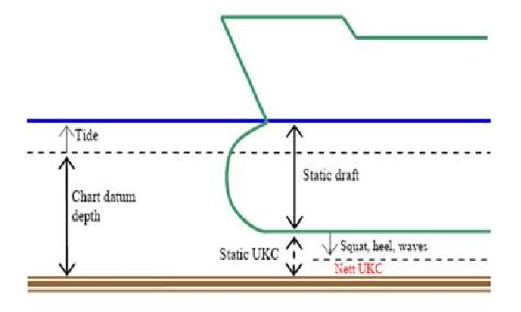
Concepts/Definitions
Underkeel Clearance (UKC)—The distance between the lowest point of the ship's hull, normally some point on the keel, and the sea floor. (IHO Hydrographic Dictionary)

Slide 5
Concepts/Definitions (Cont.)
Underkeel Clearance Management (UKCM) System—(1) A contemporary Aid to Navigation (AtoN) which enhances navigational safety. (AMSA) (2) A real-time and nowcast/forecast model system, in conjunction with the vessel response prediction systems, giving the vessel’s master the information need to effectively manage the vessel’s underkeel clearance. (Adapted from Modern Underkeel Clearance Management published in the International Hydrographic Review, Monaco LXXV(2), September 1998)
Static Systems—Vessels use pre-calculated information to determine their underkeel clearance, with no shore or web-based interactions. (NIPWG)
Dynamic Systems—Vessels monitor their underkeel clearance in real-time using either a web-based system (vessel must pre-register to participate in the system) or a hardware/software-based system (vessel must purchase an approved system loaded with appropriate software to obtain real-time information concerning its underkeel clearance). (NIPWG)

Slide 6
Outcome of S-129 Project Team meeting
Use of the words “static” and “dynamic” that was used in the NIPWG definitions was agreed as being readily understandable due to the existing uses of the words.
The S-129 PT further developed definitions of Static and Dynamic Under Keel Clearance Management as follows:

Slide 7
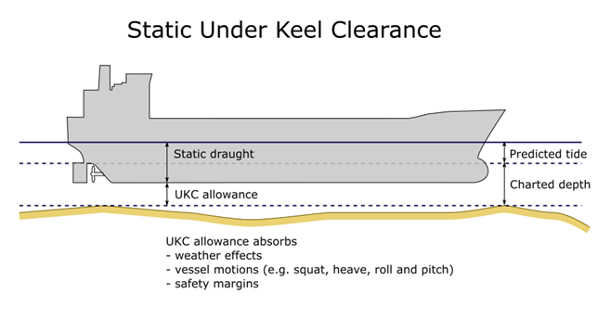
S-129 PT Proposed Static UKCM Definition
Static Under Keel Clearance Management — A method based on rules that uses a vessel’s static draught measurements and predicted tidal or water level information to estimate a vessel’s under keel clearance when underway in a depth constrained waterway. Static Under Keel Clearance Management approaches do not involve real-time interaction between vessels and shore-based service providers.

Slide 8
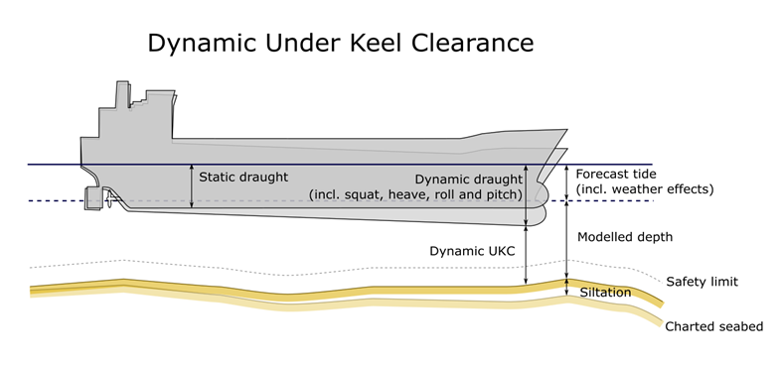
S-129 PT Proposed Dynamic UKCM Definition
Dynamic Under Keel Clearance Management — A system that typically involves interaction between vessels and shore-based service providers and which calculates a vessel’s under keel clearance. Dynamic Under Keel Clearance Management Systems use sophisticated models and real-time met-ocean inputs to produce vessel-specific services (e.g. tidal windows, routes, no-go and almost no-go areas) to ensure minimum under keel clearances are maintained.

Slide 9
Recommendations
Finalize Dynamic and Static definitions
Submit final definitions to the Hydrographic Dictionary Working Group (HDWG)
Liaise with S-129PT for possible impact of the S-129 Product Specification
Underkeel Clearance Management (UKCM) System to also be included in IHO Hydrographic Dictionary?

